Slide 1

Sentiment Analysis of COVID-19 Tweets – Visualization Dashboard
Prepared By:- Janki Patel
Aneri Shah
Sanjeev Khatwani
Team name:- Emo-co-ti
College:- LDRP – ITR,
Gandhinagar

Slide 2


Technologies and Software used:
Node Red
Cognos Dashboard
Tone Analyser
Jupyter Notebooks (python)
Excel

Slide 3

Phases Involved:
Fetching Data and Data Pre-Processing
Making the UI in NODE RED
Fetching Live tweets in Node Red as well as using Scraping
Plotting various visualizations and getting insights
Using the pre-processed data in Cognos Dashboards

Slide 4
6. Tone wise analysis of tweets
7. Location-wise analysis using dashboards
8. Using Pre-Processed Data For ML
9. Allowing users to analyse their tweets before posting
10. Predicting the mood if the lockdown extends

Slide 5
Fetching data and Data Pre-processing:
We used the Twython Library to fetch the tweets from the tweet ids that were mentioned in (IEEE csv files).
We intentionally chose the dates on which Lockdown announcements were done to get insights on people’s mood.
Then we processed the data by cleaning it using various techniques (removed the stop words ‘#’, ‘@’, hyperlinks etc.).

Slide 6

Making the UI in NODE RED:
The Node Red UI contains 3 main elements
The Sentiment Analysis dashboard
The Location wise analysis
The Tweet Analyser

Slide 7
Fetching Live tweets in Node Red as well as using Scraping:
For Fetching live data we have used the sentiment analysis node in twitter
For scraping (India) we have used the data from the Ministry of health and family welfare website (https://www.mohfw.gov.in)
For scraping (India) we have used the data from the Worldometer website (https://www.worldometers.info/coronavirus/#countries)

Slide 8

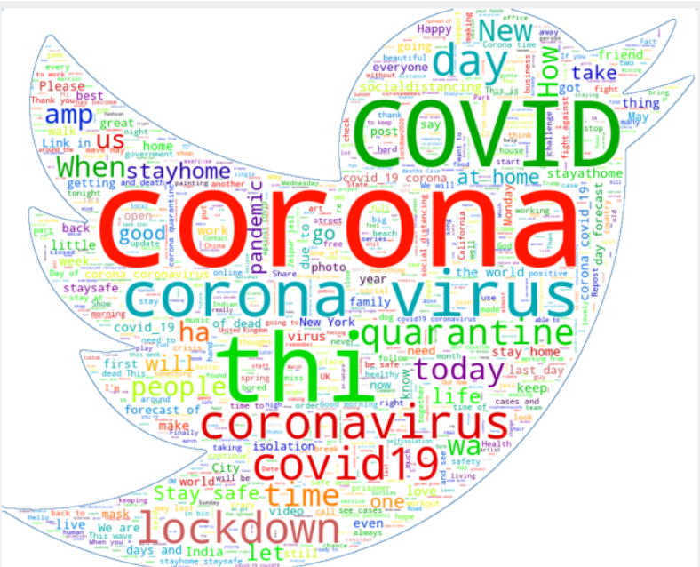
Plotting various visualizations and getting insights:

Slide 9

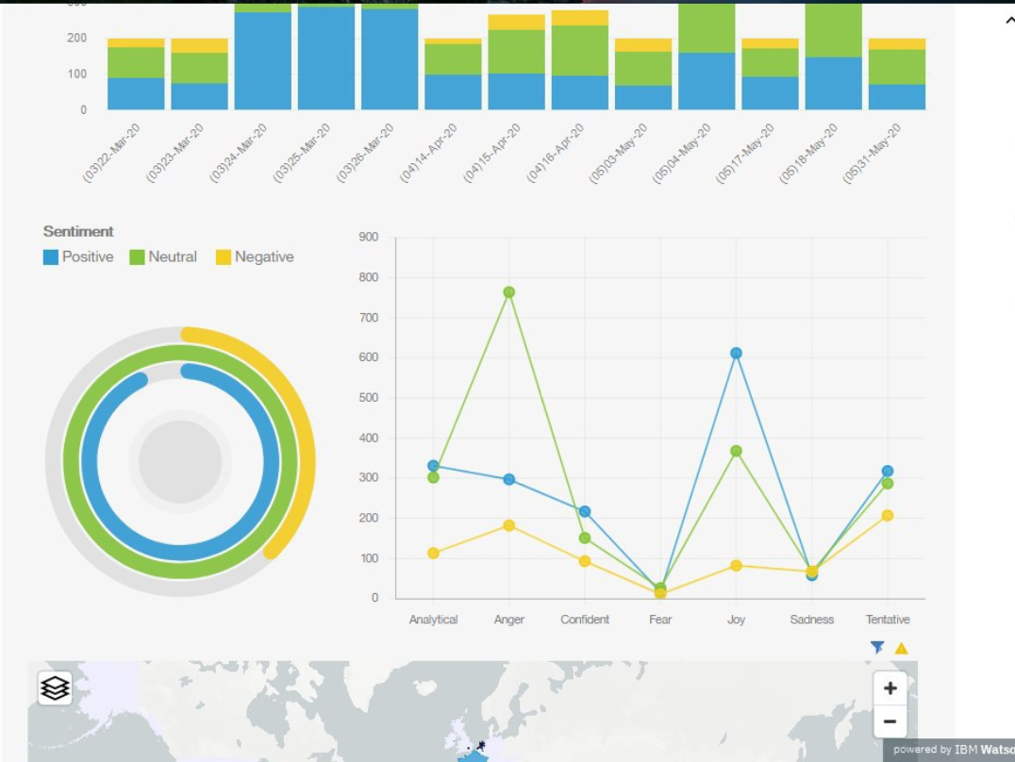
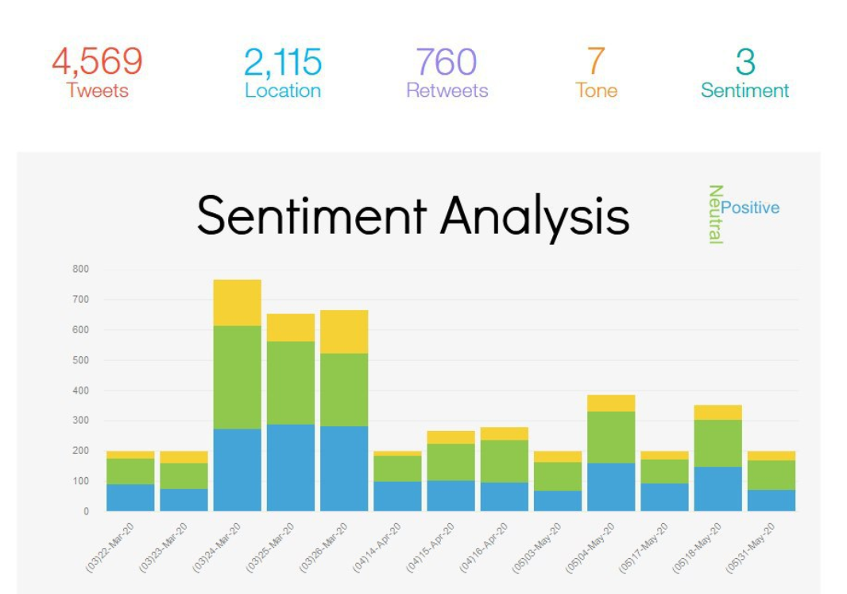
Using the pre-processed data in Cognos Dashboards:

Slide 10
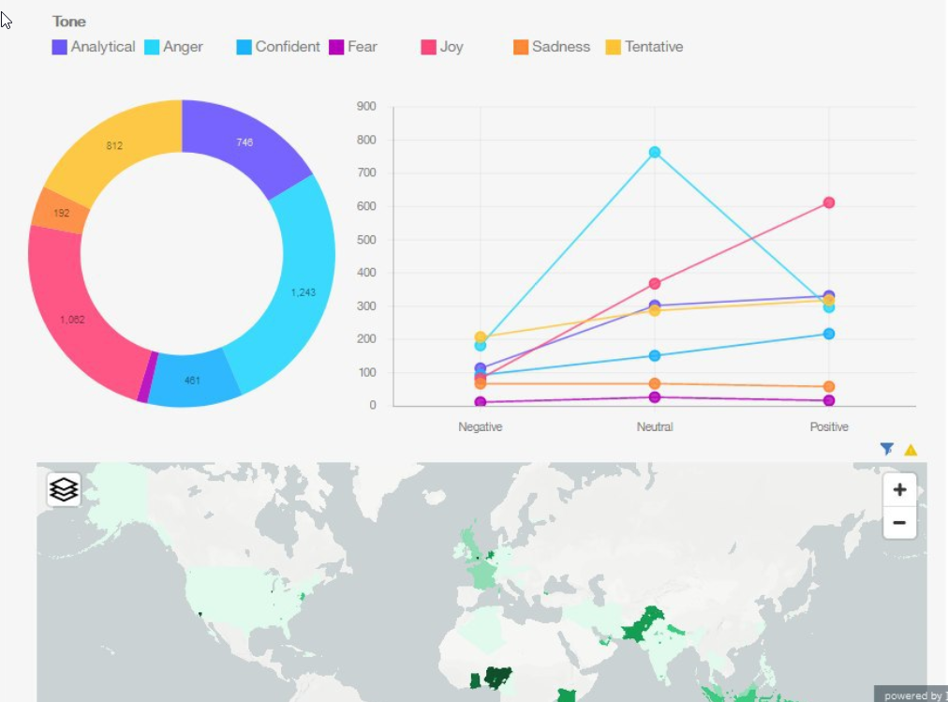
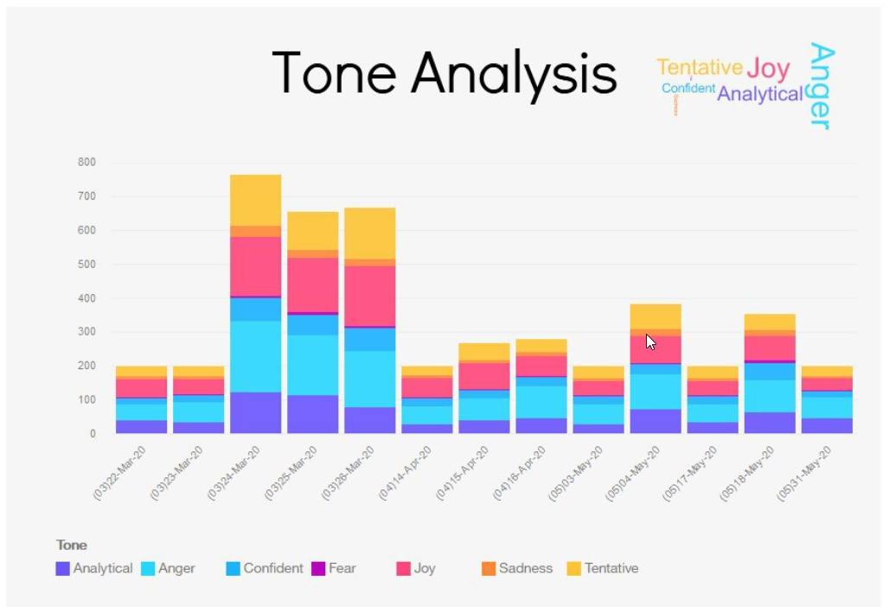
Tone wise analysis of tweets:

Slide 11
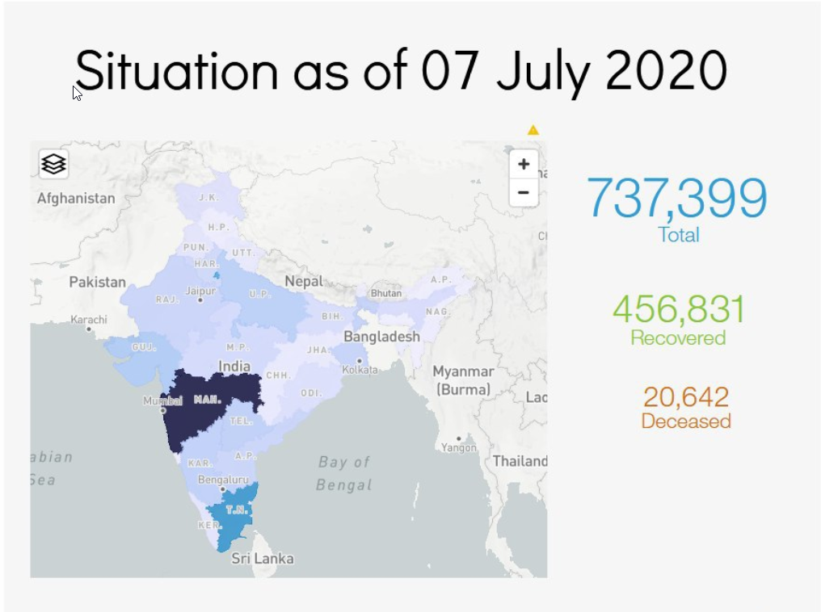
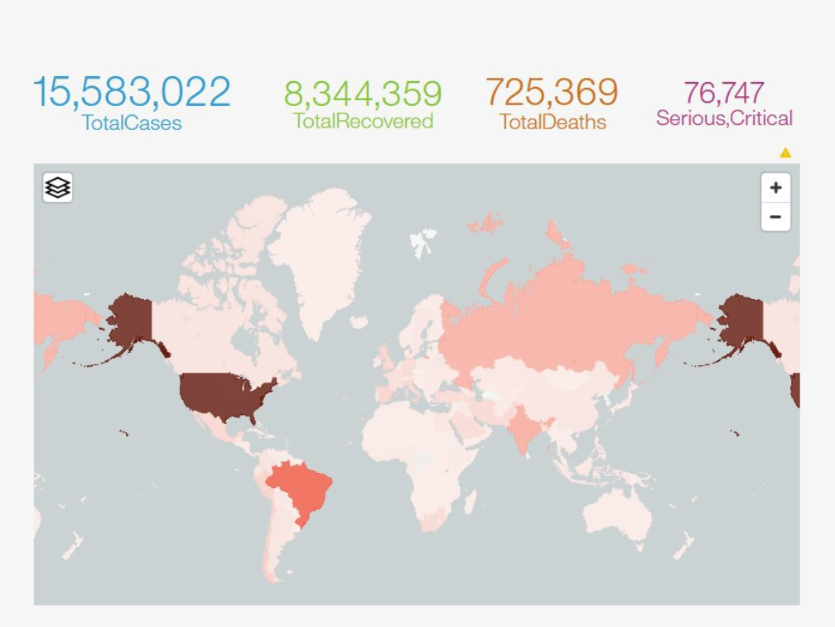
Location-wise analysis using Cognos dashboards:

Slide 12
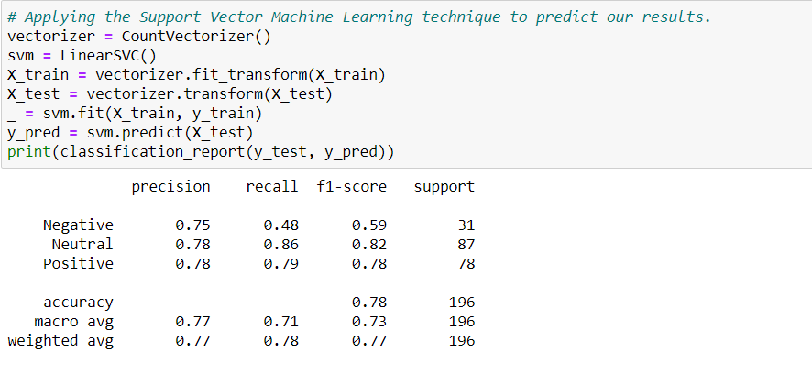
Using Pre-Processed Data For ML:

Slide 13
Allowing users to analyse their tweets before posting:
We have added a functionality which lets the user check what is the sentiment of his tweet before posting
He just has to type out his tweet and click on check and he will receive a score between -5 and 5
-5 being a highly negative one and +5 being a positive one

Slide 14

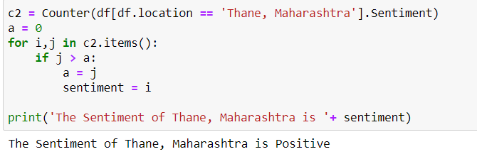
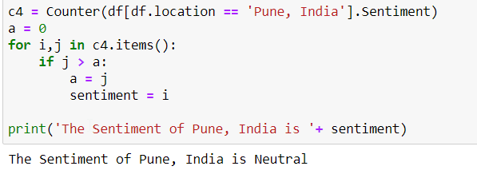
Predicting the mood if the lockdown extends

Slide 15


